Slide 1
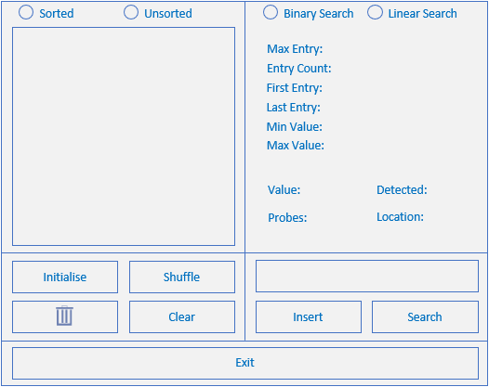
Sorted_Btn
unsorted_Btn
binaryS_Btn
linearS_Btn
Shuffle_Btn
Statistics
Initialise_Btn
Insert_Btn
Delete_Btn
Search_Btn
Clear_Btn
Exit_Btn

Slide 2
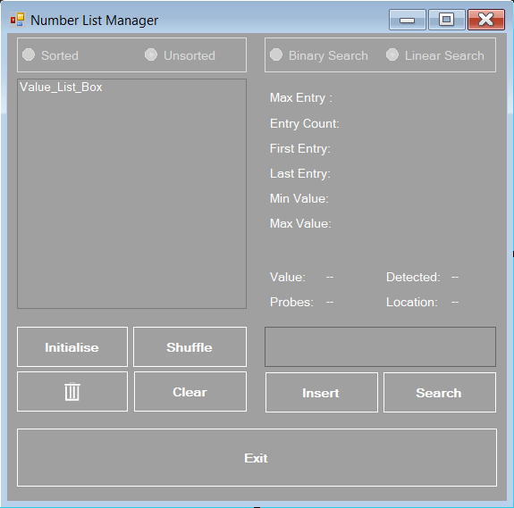
Sorted_Btn_CheckedChanged(), Sortlist()
unsorted_Btn_CheckedChanged()
binarySearch(value)
linearSearch(value)
Shuffle_Btn_Click()
Initialise_Btn_Click()
Insert_Btn_Click()
Delete_Btn_Click()
Search_Btn_Click()
Clear_Btn_Click()
Exit_Btn_Click()

Slide 3
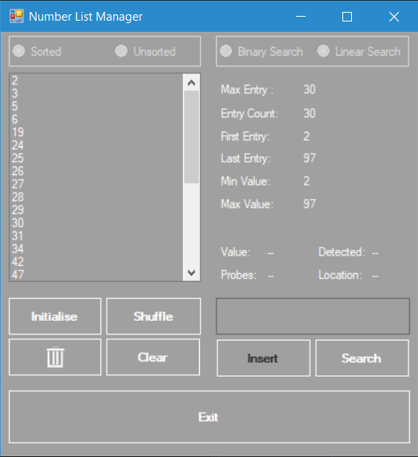
unsorted_Btn.checked = fale
sorted_Btn.checked = true
binaryS_Btn.enabled = true
linearS_Btn.enabled = true

Slide 4
